Slide 1
Open Science to Link MFA and LCA
Summer School 2025
Singapore

Slide 2
Investigation of End of Life Strategies for Wind Turbines
Group Work

Slide 3
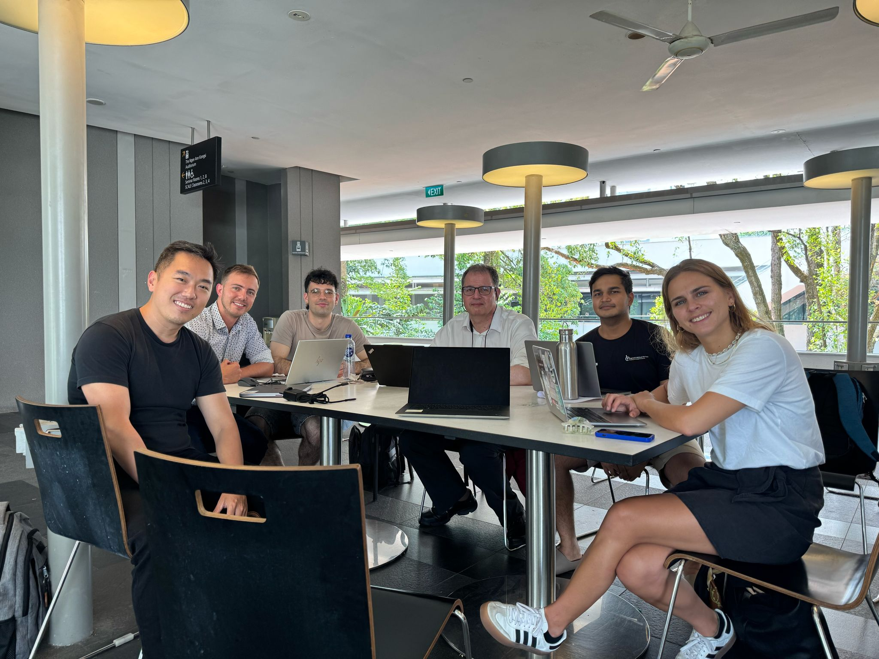
Group Members
Edwin
Natanael
Prasham
Leonardo
David
Carmen
Zhao Yang

Slide 4
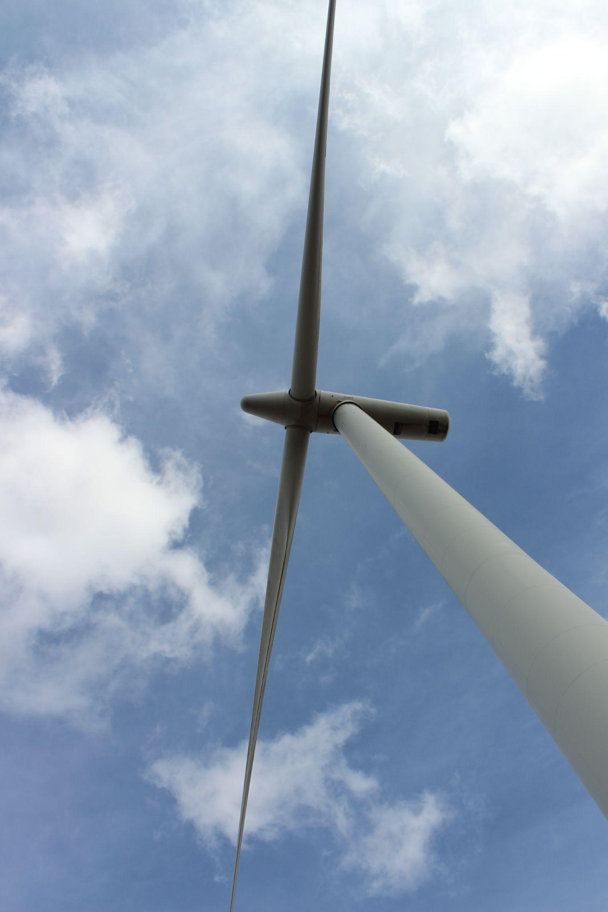
Background
Wind turbines have become an ubiquitous feature of the landscape in many parts of the world.
It is estimated that there will be over 80,000 wind turbines installed by 2050
With an expected useful life of between 20 and 25 years, questions arise about what to do with the asset as it approaches its end date

Slide 5
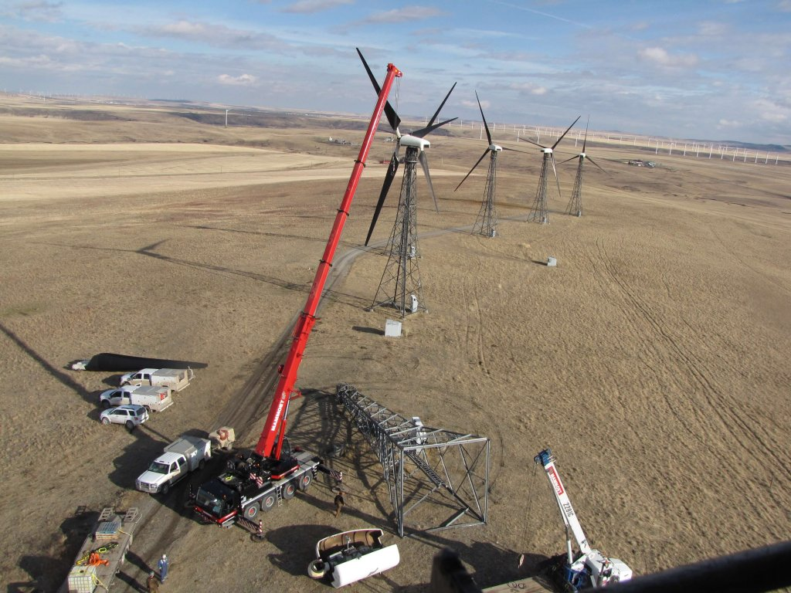
Background
There are commonly three strategies which can be adopted
Decommission the wind turbine by removing all parts of the infrastructure and return the land to its original state
Refurbish the wind turbine by replacing worn parts and upgrading components where required
Repower the site by removing the wind turbine and installing a new model while utilising the current infrastructure

